Slide 1
Variables & Scope
variables, zero value, scope, capitalization

Slide 2
“There are only two hard things in Computer Science:
cache invalidation and naming things.”
~ Phil Karlton

Slide 3
variables

Slide 4
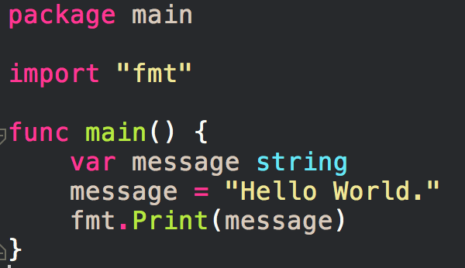

Slide 5
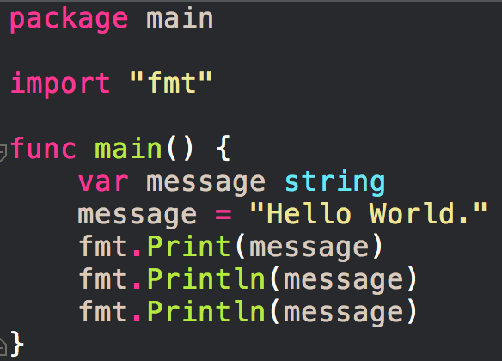

Slide 6
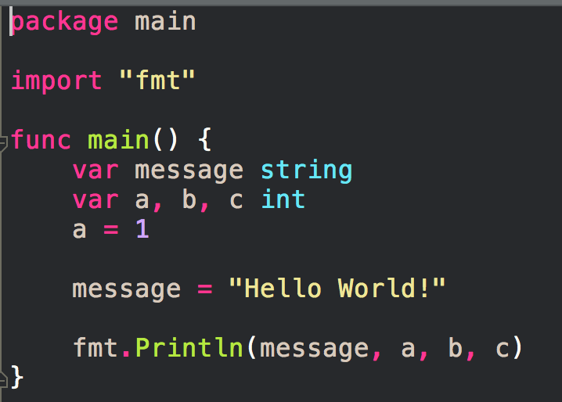

Slide 7
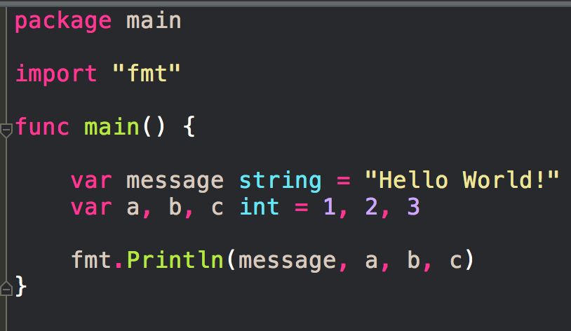

Slide 8
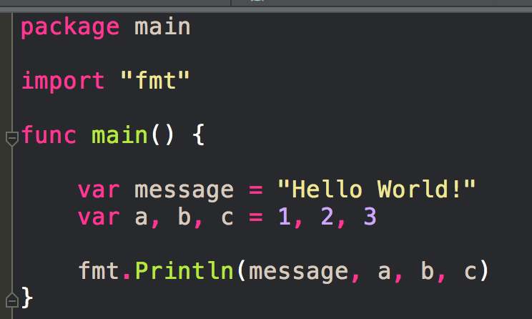

Slide 9
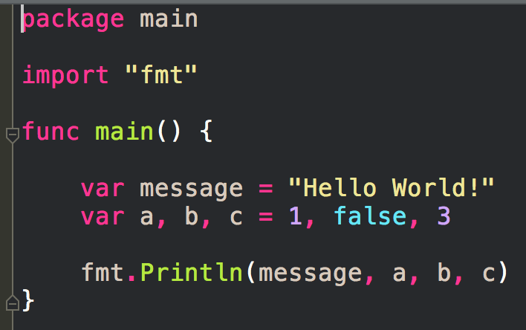

Slide 10
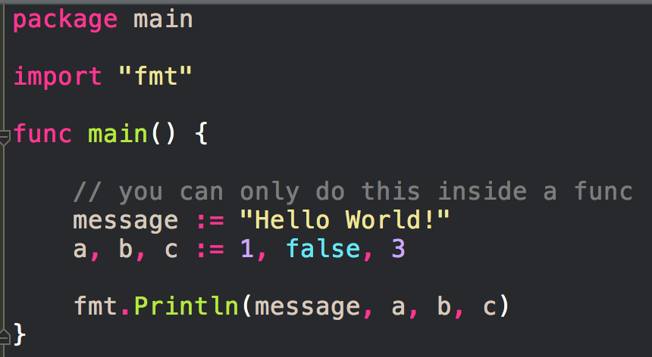

Slide 11
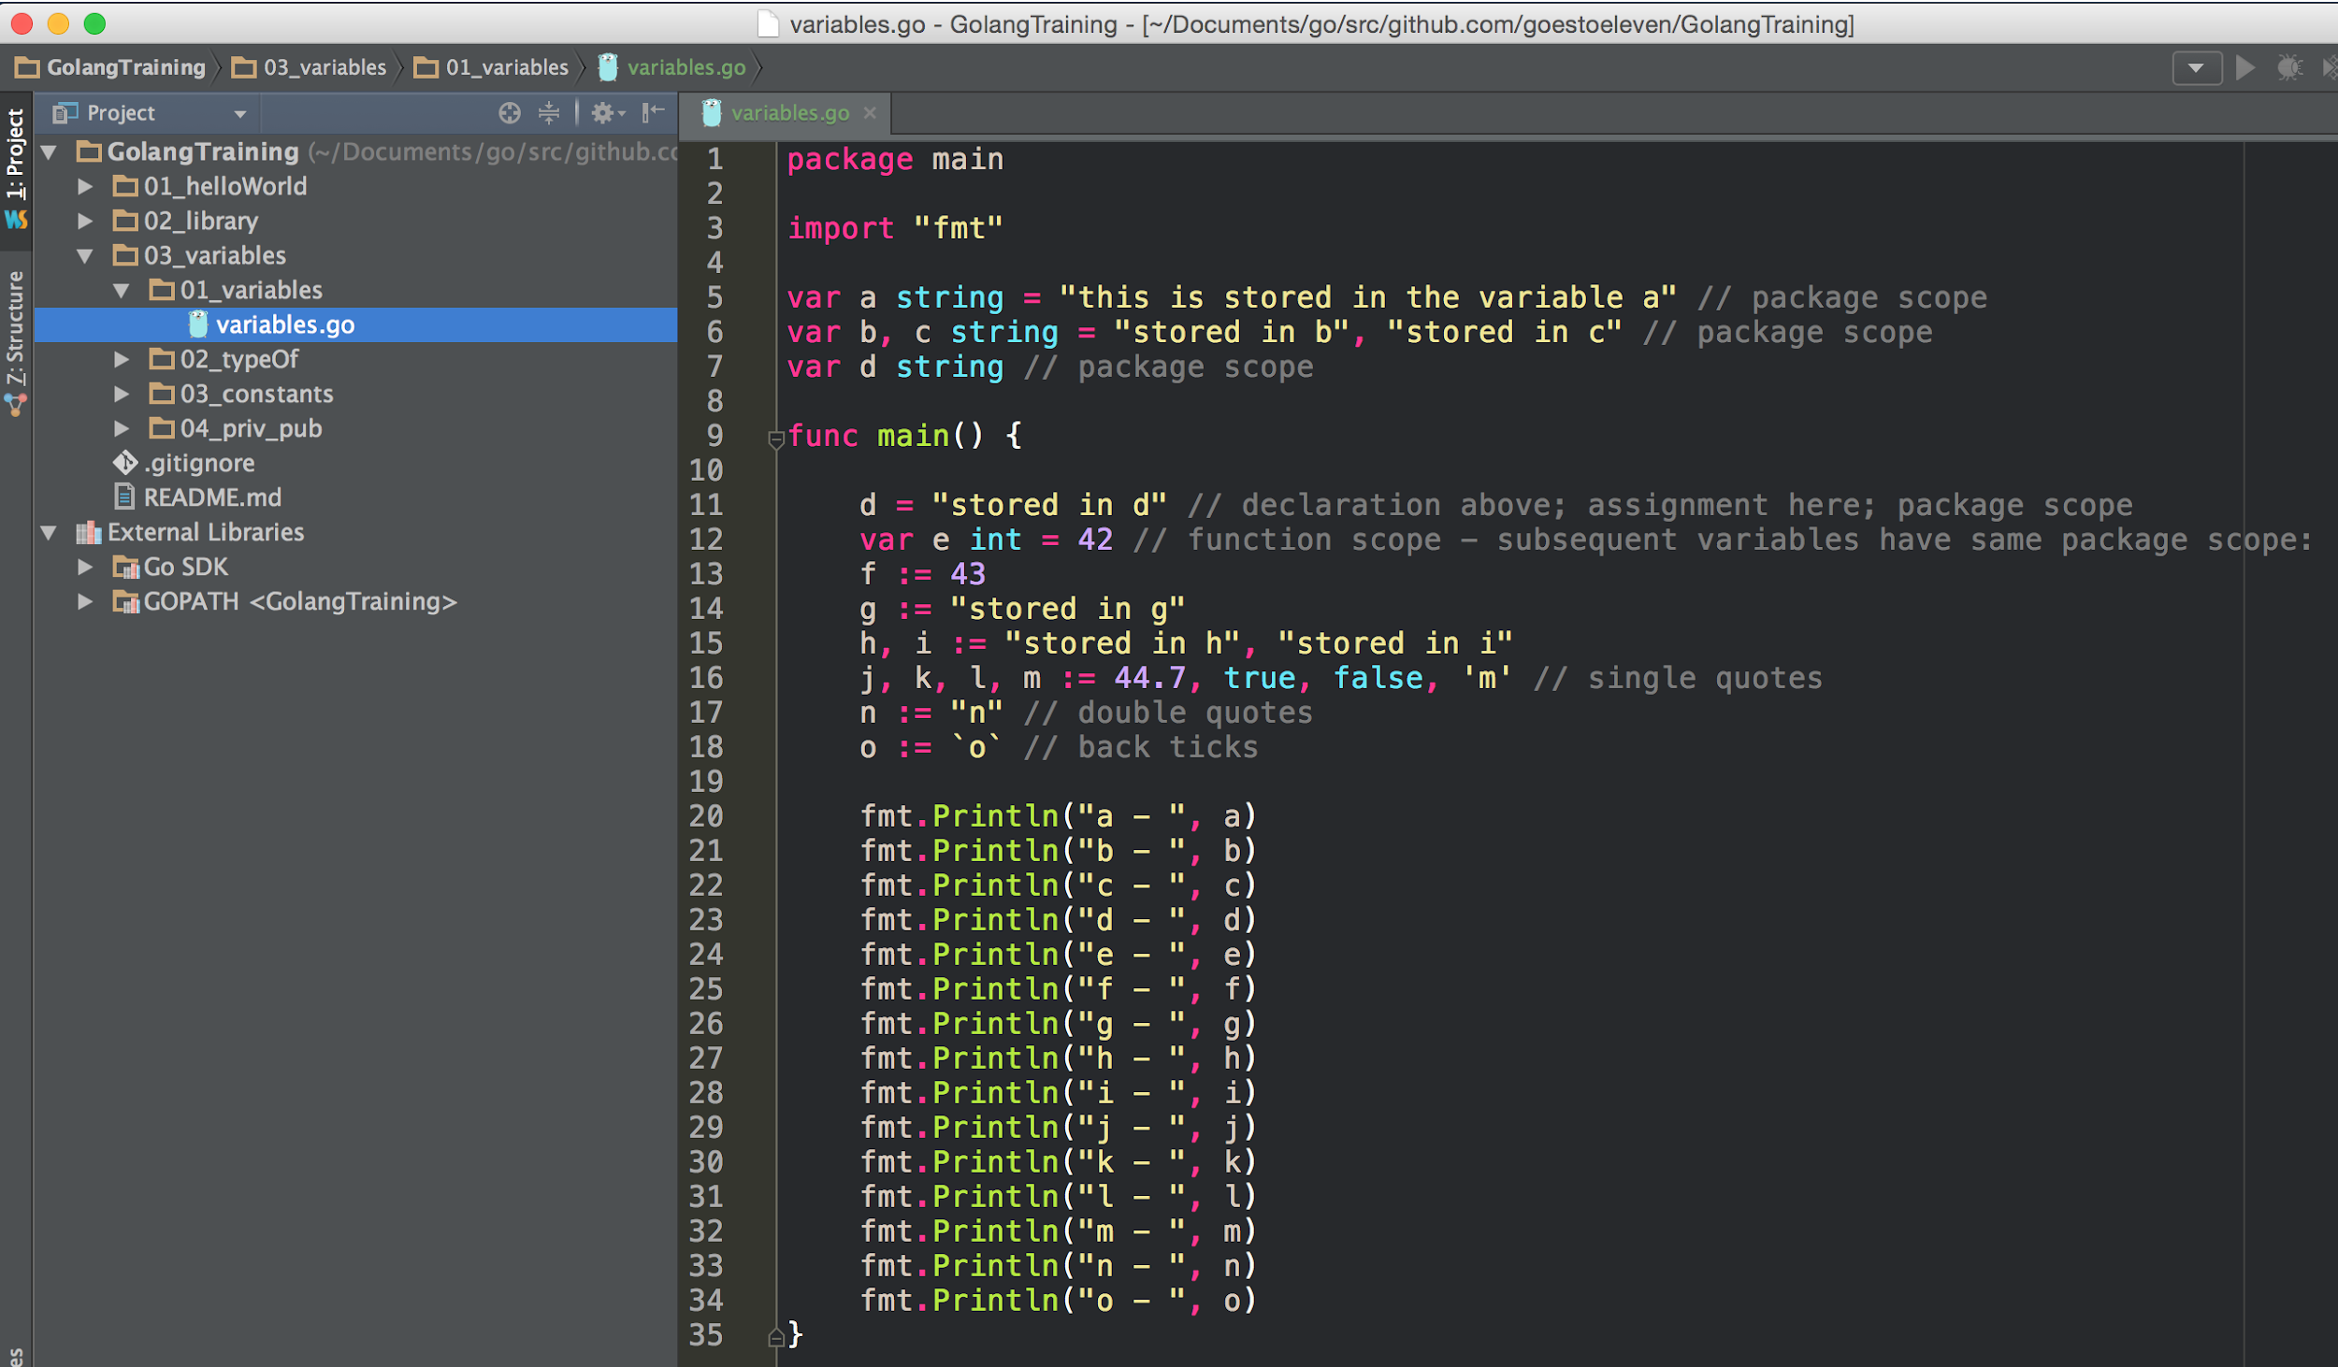

Slide 12
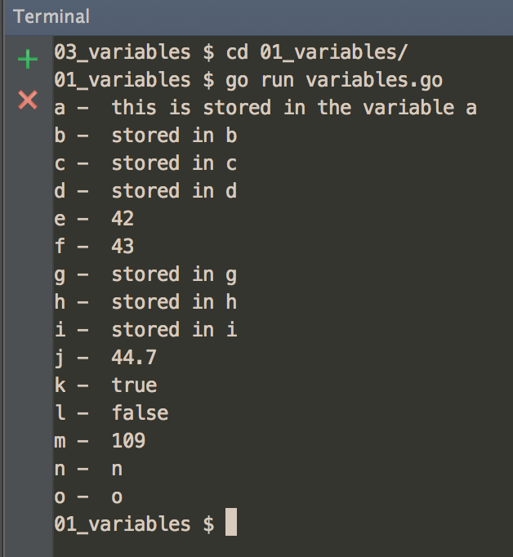
Lexical Elements

Slide 13
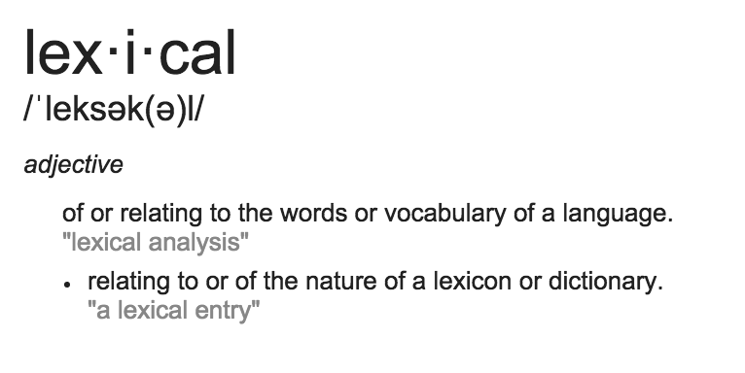
lexical
Lexical Elements

Slide 14
declare, assign, initialize
declare + assign = initialize

Slide 15
exercise
declare a variable of type string
assign it the value of your name
use the variable in an statement

Slide 16
zero value
false for booleans, 0 for integers, 0.0 for floats, "" for strings
nil for pointers, functions, interfaces, slices, channels, and maps
https://golang.org/ref/spec#The_zero_value

Slide 17
scope
universe → package → file → function → curly braces
https://golang.org/ref/spec#Declarations_and_scope

Slide 18
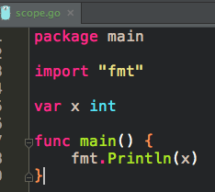
package level scope

Slide 19
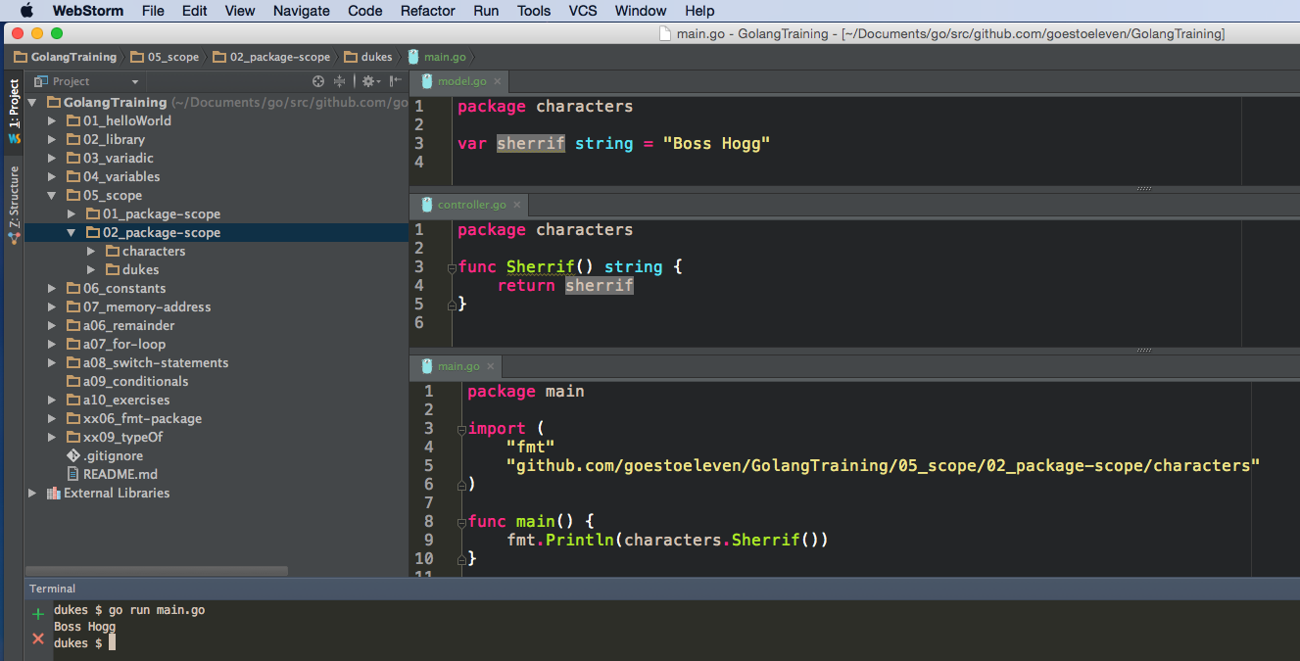
package level scope

Slide 20
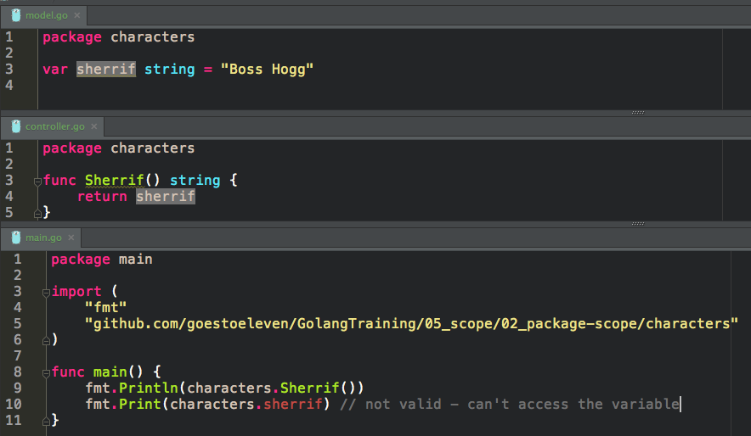
package level scope
invalid
variables declared at the top level (outside a function) have a package scope

Slide 21
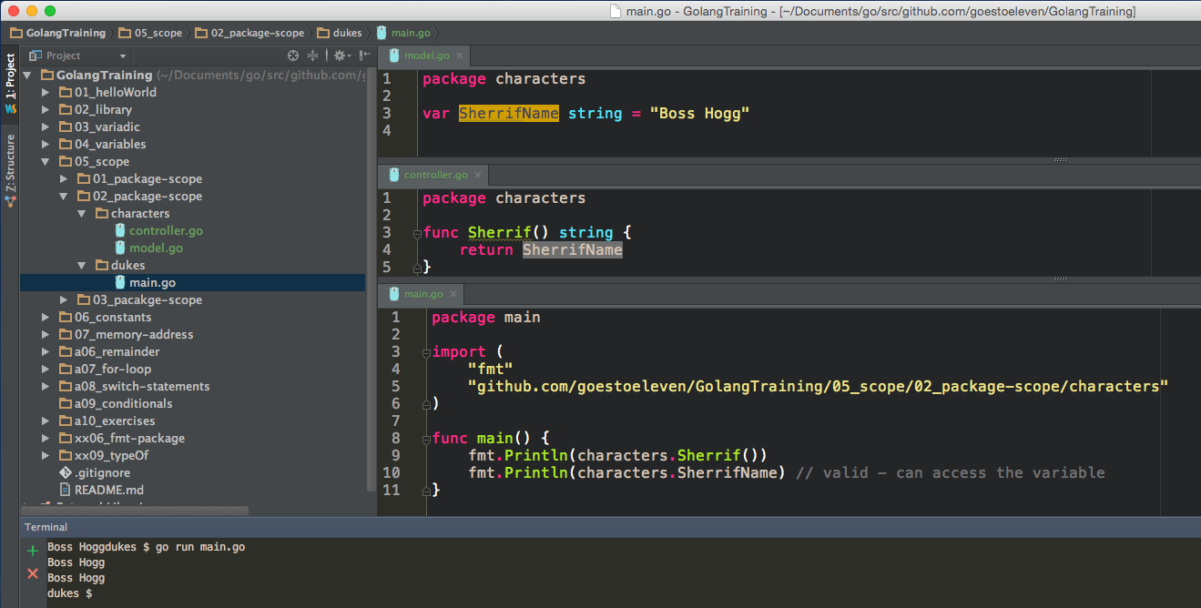
Capitalized variables and functions are accessible outside the package; like “public” in some languages
package level scope

Slide 22
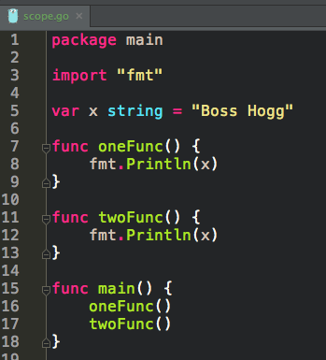
package level scope

Slide 23
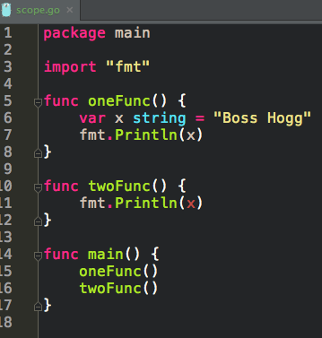
invalid
scope of variable x is within the function in which it is declared

Slide 24
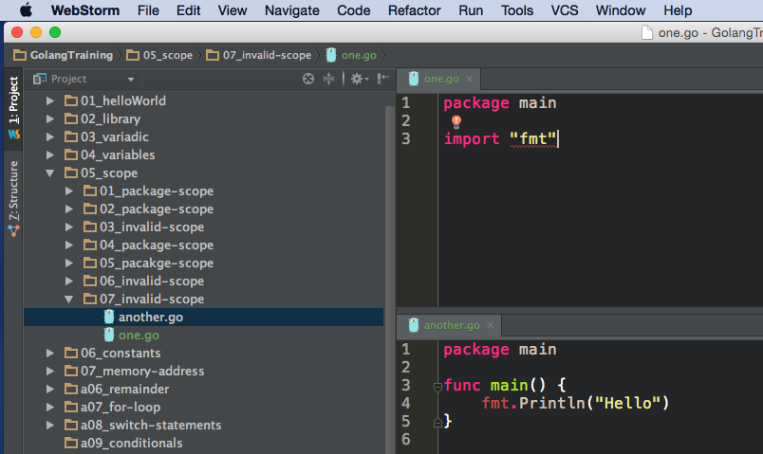
invalid
imports have a file scope

Slide 25
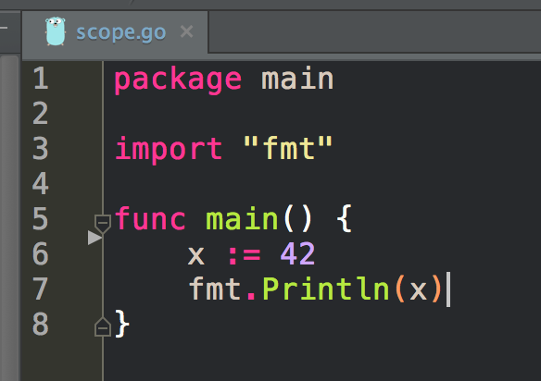
func level scope

Slide 26
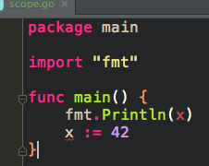
invalid
you can’t use a variable before it is initialized; there is no hoisting like in javascript

Slide 27
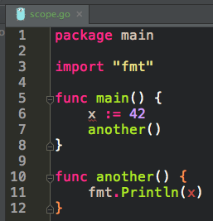
invalid
scope of variable x is within the function in which it is declared

Slide 28
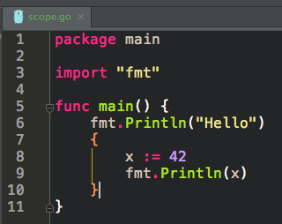
curly-braces level scope

Slide 29
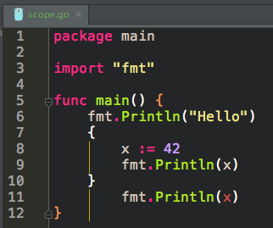
invalid
scope of variable x is within the curly-braces in which it is declared

Slide 30
resource
learn more about scope

Slide 31
capitalization
Public, private

Slide 32
Capitalized variables and functions are accessible outside the package; like “public” in some languages
We already saw this
package level scope
Capitalized top-level variables, and functions, are accessible outside the package.

Slide 33
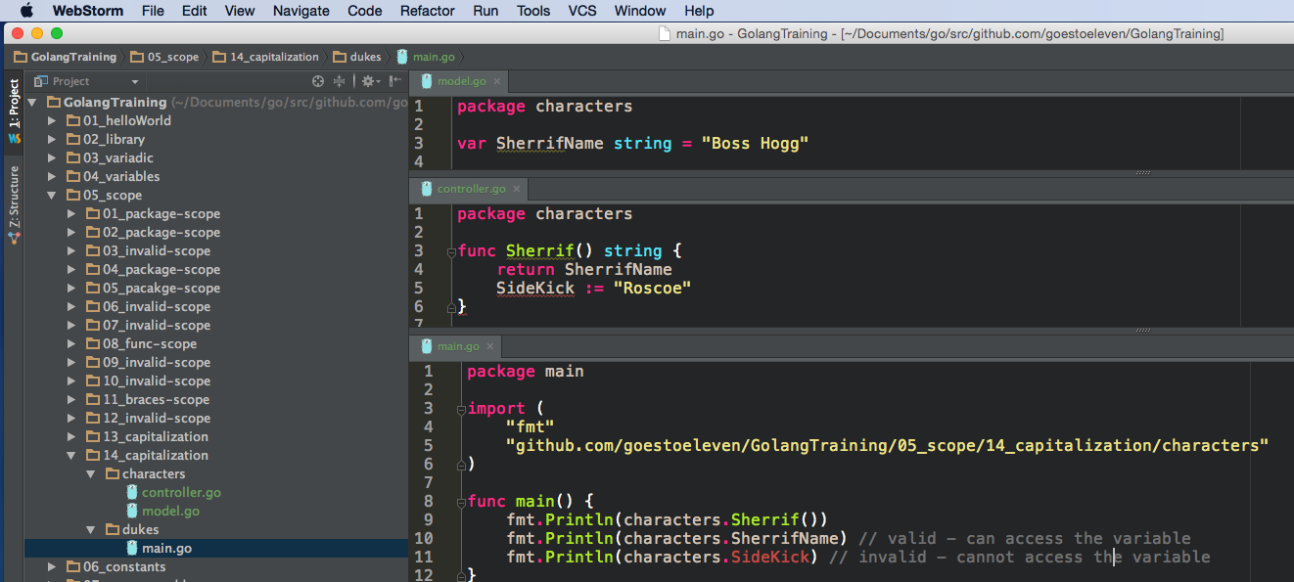
invalid
scope on SideKick is func scope
Capitalized top-level variables, and functions, are accessible outside the package.

Slide 34
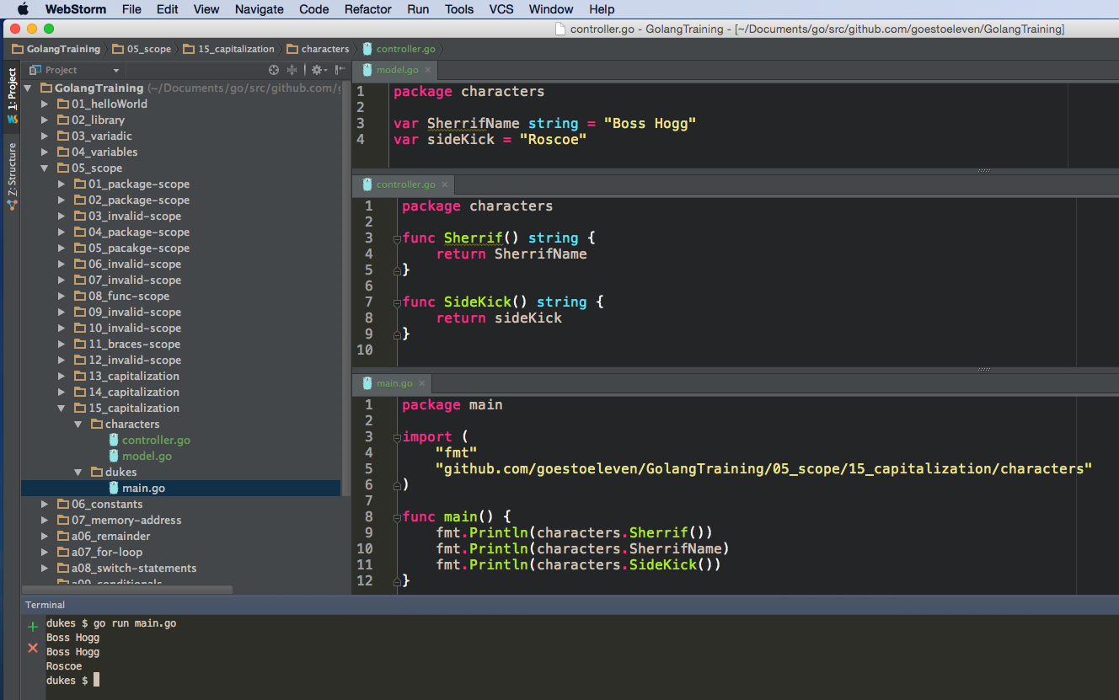

Slide 35
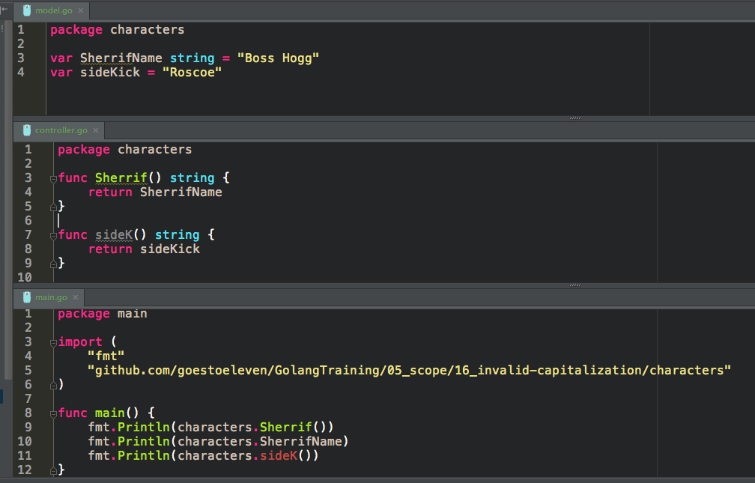
invalid
scope on sideK() is package scope

Slide 36
exercise
create a package main
create a package names
create the variable MyName and assign it a name
use MyName in package main
take a screenshot
create the variable yourName and assign it a name
what happens when you use yourName in package main?
take a screenshot

Slide 37
_ blank identifier
for a variable you don’t want to use

Slide 38
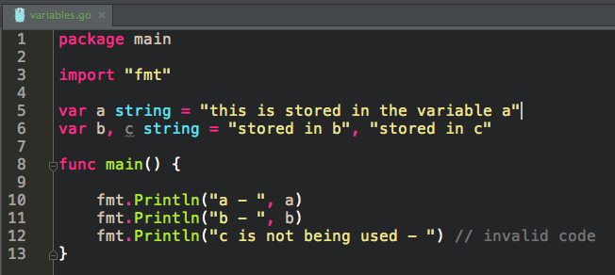

Slide 39
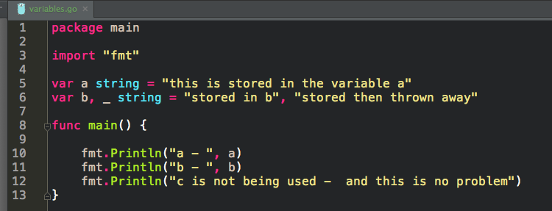

Slide 40
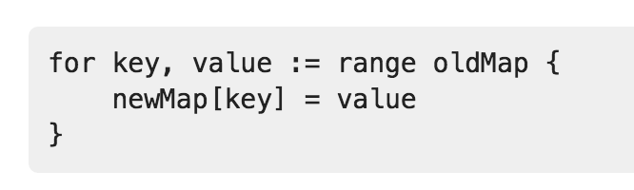
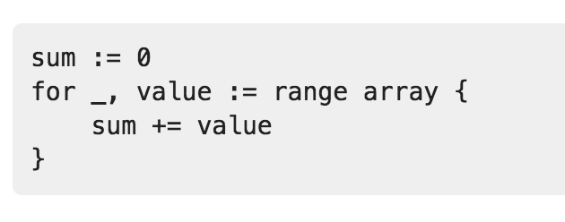

Slide 41
Review
can occur anywhere in your code
var a string = "this is stored in the variable a"
var b, c string = "stored in b", "stored in c"
var d string
const p string = "death & taxes"
const q = 42
this lexical element := can only occur inside a function
f := 43
g := "stored in g"
h, i := "stored in h", "stored in i"
j, k, l, m := 44.7, true, false, 'm' // single quotes
n := "n"
o := `o` // backticks
fmt.Println("a - ", a)
declare + assign = initialize
capitalization
Public
private
blank identifier

Slide 42
Review Questions

Slide 43
lexical elements
What are lexical elements? Give a few examples of lexical elements in golang.

Slide 44
golang spec
Open the golang spec
Under lexical elements, find the golang keywords
take a screenshot of this

Slide 45
golang spec
Open the golang spec
What are the two types of comments which may be used in golang code?

Slide 46
golang spec
Open the golang spec
What is an identifier?

Slide 47
golang spec
Open the golang spec
According to the golang spec, the first character in an identifier must be what?

Slide 48
golang spec
Open the golang spec
Find the operators which you can use in golang.
take a screenshot of this

Slide 49
zero value
Describe zero value and how it occurs

Slide 50
zero value
What are the zero values for each of the following:
int
float
string
pointer
boolean

Slide 51
scope
What are the levels of scope within golang?

Slide 52
scope
When you import a package in a file, what is that package’s scope? For example, is “fmt” available in file f1.go?

Slide 53
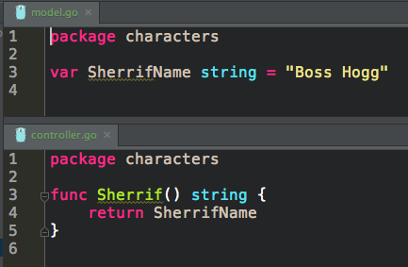
scope
When you declare a variable at the top-level (not in a function), and when you make that declaration in a file that is in a package, what is that variable’s scope? For example, is the code below valid?

Slide 54
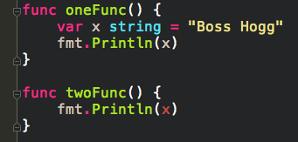
scope
Is this code valid? Why or why not?

Slide 55
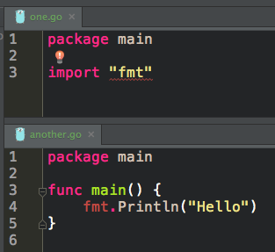
scope
Is this code valid? Why or why not?

Slide 56

scope
Is this code valid? Why or why not?

Slide 57
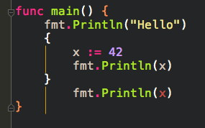
scope
Is this code valid? Why or why not?

Slide 58
scope
How is the scope of a function changed when you capitalize the first letter of a function?

Slide 59
scope
How is the scope of a variable changed when you capitalize the first letter of a variable?

Slide 60
scope
Can you capitalize func main? Would you want to?

